Slide 1
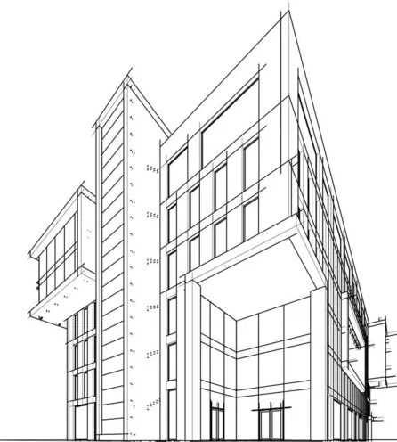
“ONE-STOP SHOP” DEVELOPMENT OFFICE
City of Forest Park
Department of Planning & Community Development
Notes:
Hello and welcome the city of forest park one stop shop development services office. This office is located in the Planning & community development building @785 forest parkway. Additionally ,the Code Enforement and Econonic development departments also reside at this location.

Slide 2
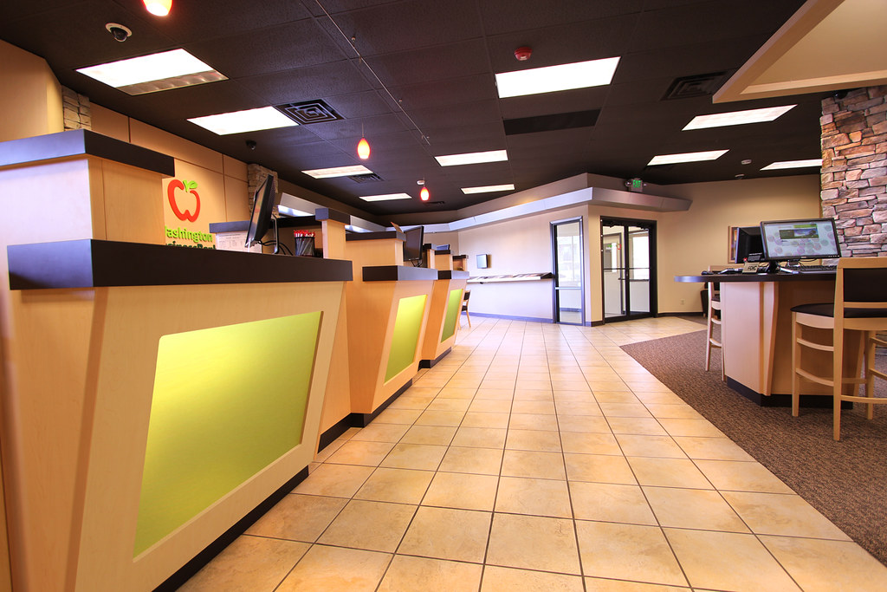
WHAT IS A “ONE-STOP SHOP”?
A one-stop shop is a government office that offers a variety of permits and services in one location. This allows customers to access these services in a centralized location rather than in different places, improving the delivery of government services to citizens.
The goal of a one-stop shop is to provide convenience and efficiency for customers, which can lead to loyalty, revenue and compliance with government regulations.
Notes:
So what is a one stop shop? At this offices you can speak to Building , permitting licensing economic development as well as code enforcement staff.

Slide 3
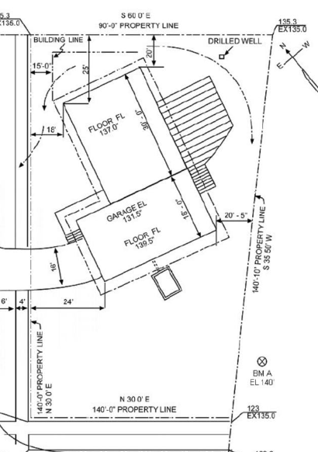
AVAILABLE SERVICES
You can apply for:
Building Licensing Planning & Zoning
Building Permits Business License Urban Review Design Board
Trade Permits Adult License Variances Sign & Deck Permits Alcohol Permitting Conditional Use Fence Permits Sound Permits Rezoning Special Event Permits Lot Split or Lot Combination Zoning Verifications
Notes:
At this office you will be able to apply for and ask questions about…
Building permits such as….
You also can also apply for your short term rental permit and film permits

Slide 4
CONCIERGES SERVICES
To assist our development community personal assistance services will be available to help developers with a variety of tasks to manage their project permitting and required approval responsibilities. The Capital Project Manager or the Sr. Planner will assist and oversee/manage projects from start to finish as a point of contact for the developer. Concierges can assist with:
Land Use Petitions
Permitting and Plan Submittals
Information about city development standards & requirements
Notes:
the city offers development concierge services, where a staff member will be assigned to assist and serve as the city contact for the developers. through the design, project approval process, design review , permitting process and business licensing.

Slide 5
DEVELOPMENT PROCESS
Step #1
Set up a Pre-Development meeting with planning staff.
This is for new development, redevelopment, renovations and expansions/additions. Meetings are available weekly.
Step #2
Obtain needed approvals.
Apply for rezoning, conditional use, variances, lot combination, replat and Urban Design Review Board (as applicable).
Step #3
Apply for your Land Development Permit (LDP).
Apply for your Building permits. 10-day process.
Once building is completed then Apply for your Business license (if applicable).
Up to 10 -days to process.
Timeframe : 20 days -3 months
Up to10-day process.
FIRST RESPONDERS OF INFORMATION
Notes:
Our three step development process ensures that important information is provided as soon as possible to the developer. To insure complete and accurate submittals. for approvable projects. Step 1…..Pre- development meeting can include building, fire as well as economic development.

Slide 6
MODIFYING DEVELOPING PROCESS
Step #1
Set up a Pre-Permitting meeting with permitting/planning staff.
This is for exterior facade changes or modifications. Meetings are available weekly.
Step #2
Obtain needed approval from the Urban Design Review Board.
Timeframe: Up to 20-days.
Step #3
Apply for your Building permits. 10-day timeframe.
Optional
Submit Site Plan for initial zoning review.
FIRST RESPONDERS OF INFORMATIN
Notes:
We also offer pre-permitting meeting for existing buildings for exterior façade changes or modifcation

Slide 7
THANK YOU
If you have a plan or even an idea for development in the city stop by and speak to us first. We are located at:
785 Forest Parkway. Open M-F from, 8 am to 4:30 pm.
We look forward to working with you to make
the City of Forest Park the best place to live, work and play!
Notes:
We are your first contact for development needs

Slide 8
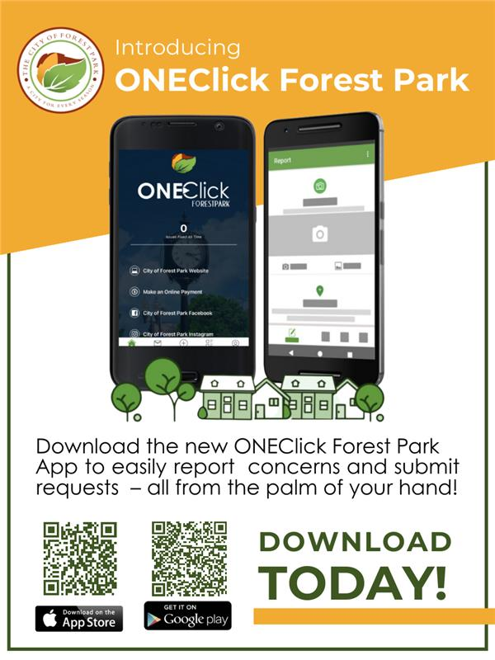
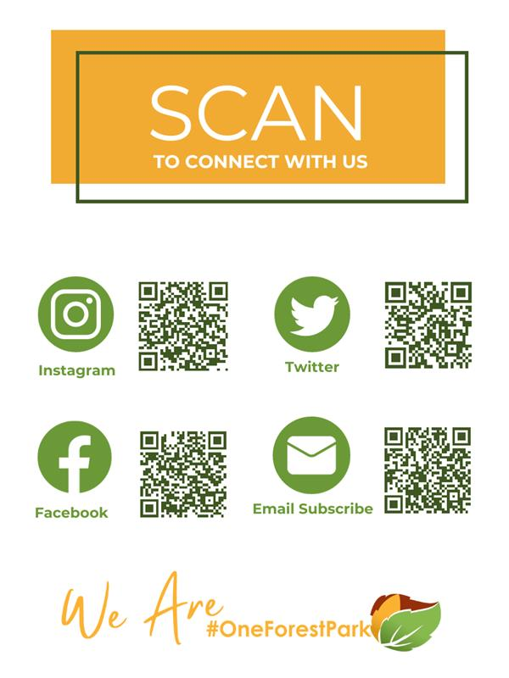
Stay Informed & Connect With Us Online!

